Slide 1
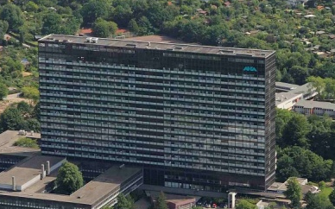
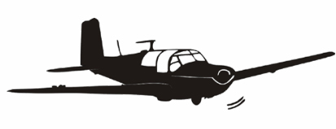
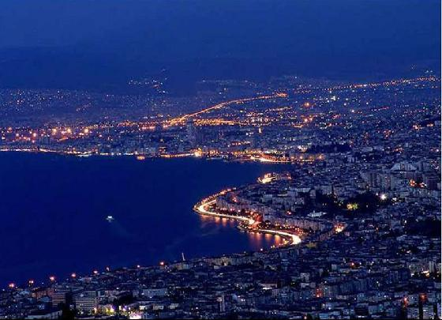
2. Şant Okulu, Izmir
Hamburg
Izmir

Slide 2
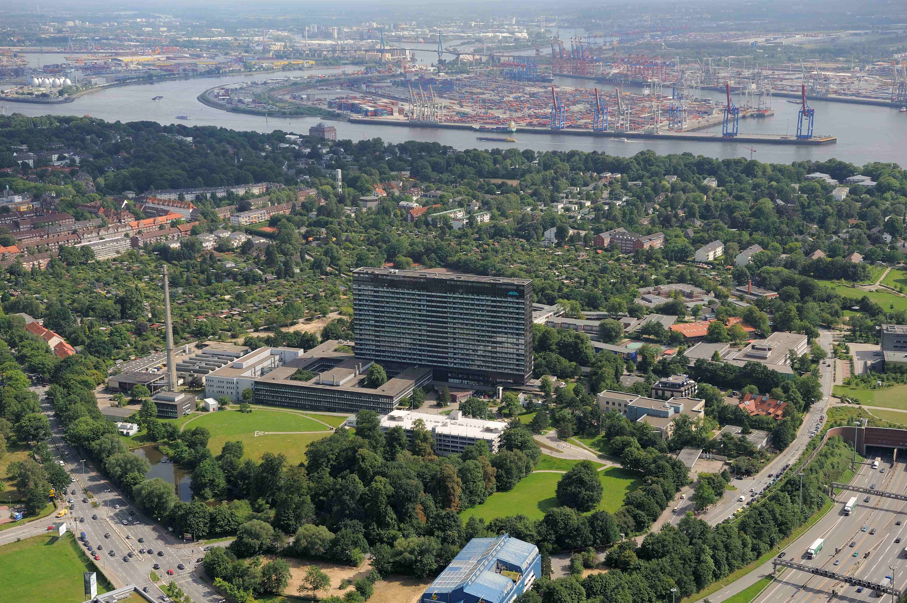
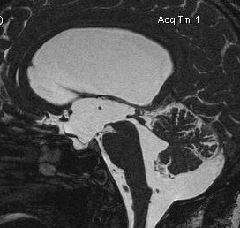
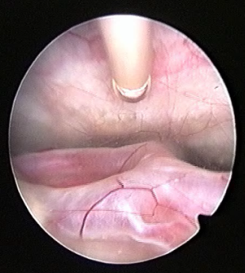
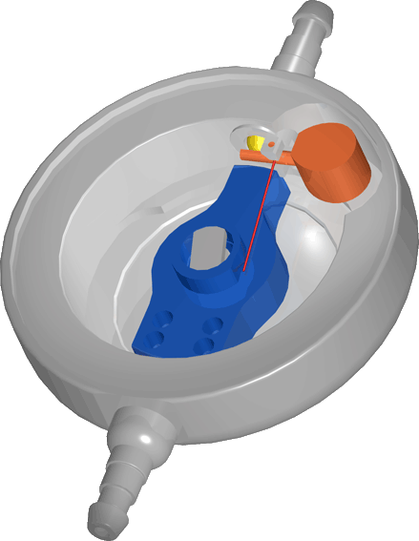
Ventriculo-peritoneal Shunt
u.kehler@asklepios.com
Notes:
2
2

Slide 3
VP– Shunt
Indications
Valve selection
Surgical aspects

Slide 4
VP– Shunt
Indications :
Symptomatic communicating hydrocephalus
(Obstructive hydrocephalus):
- if no endoscopic equipment or expertise is not available
- if endoscopic third ventriculostomy failed

Slide 5
VP– Shunt
pre-op. Diagnostics
Symptomatic „high – pressure“ or acute hydrocephalus:
clinical evaluation
and imaging (MRI/CCT)
Normal pressure hydrocephalus or chronic hydrocephalus
clinical evaluation
imaging (MRI/CCT)
and spinal tap test

Slide 6
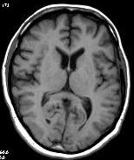
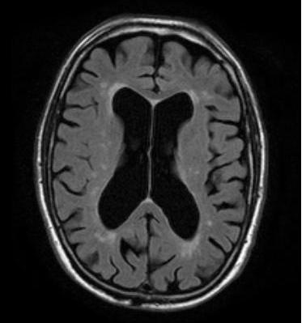
Hydrocephalus and Imaging - MRI
normal enlarged
ventricles

Slide 7
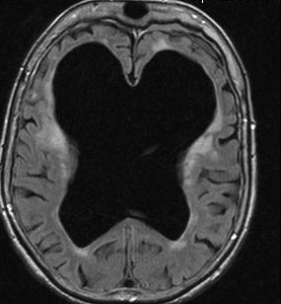
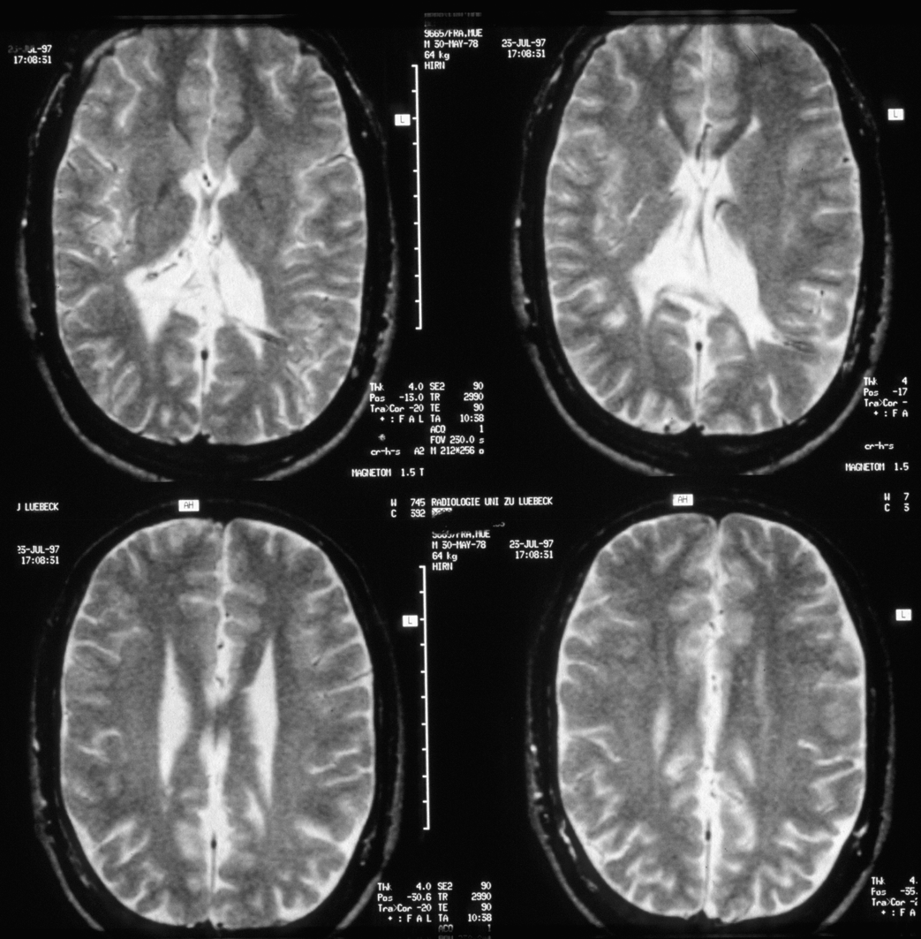
Hydrocephalus and Imaging
  Who has a symptomatic hydrocephalus?
Pat. A Pat. B

Slide 8
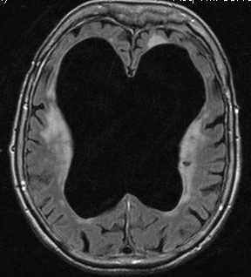
Ideopathic Normal Pressure Hydrocephalus iNPH
Hakim-Triad: Gait disturbance, Dementia, Incontinence
Ventricular enlargenment
„normaler“ ICP
clinical evaluation
imaging
invasive diagnostics
Notes:
8

Slide 9
NPH Symptoms - Hakim Triad
Gait disturbance
Incontinence
7%
11%
0,3%
48%
29%
3%
2%
Dementia
Dauch und Zimmermann 1990

Slide 10
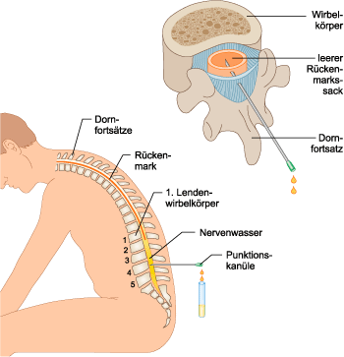
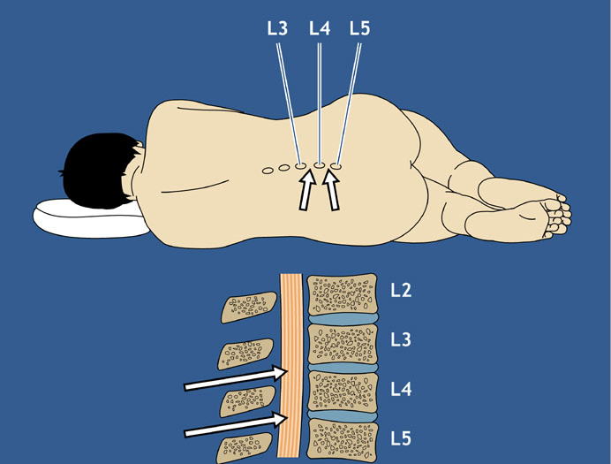
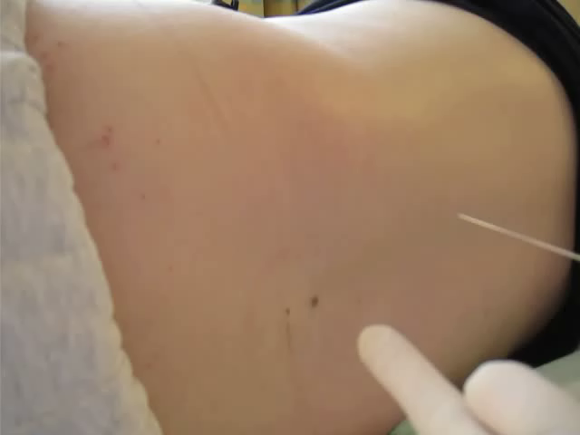
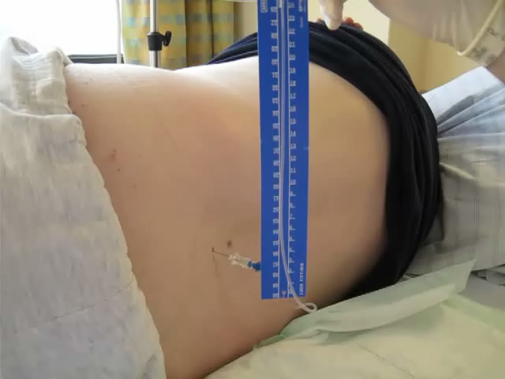
NPH - spinal tap test
  Lumbar puncture with ICP measurement
  spinal tap test (40-50ml CSF)
  clinical evaluation
  evtl. repeated STT or ext. lumbar drainage

Slide 11
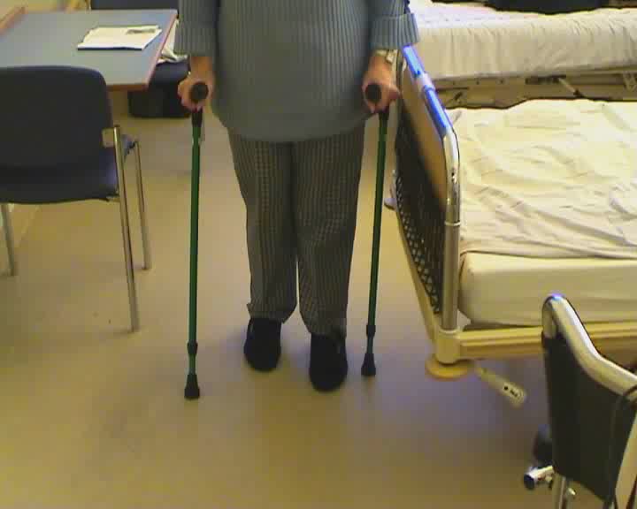
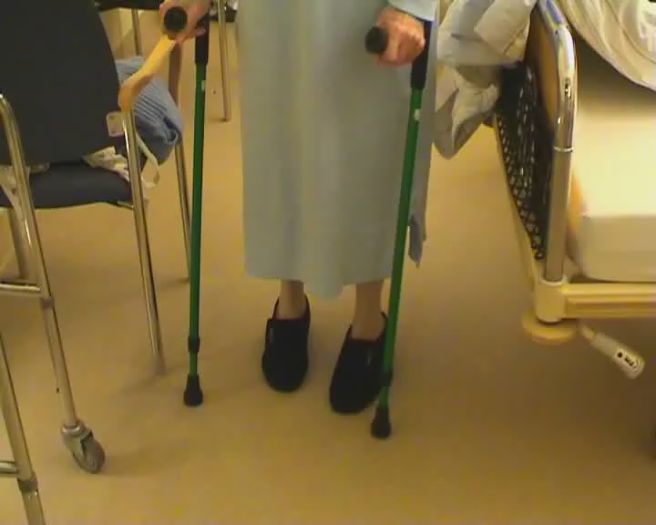
NPH - spinal tap test
  spinal tap test (40-50ml CSF) - clinical evaluation

Slide 12
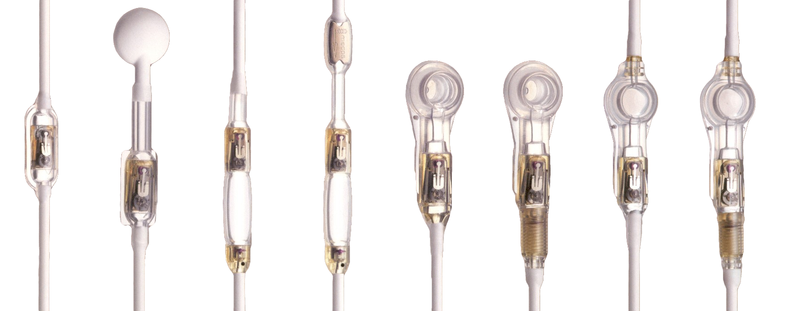


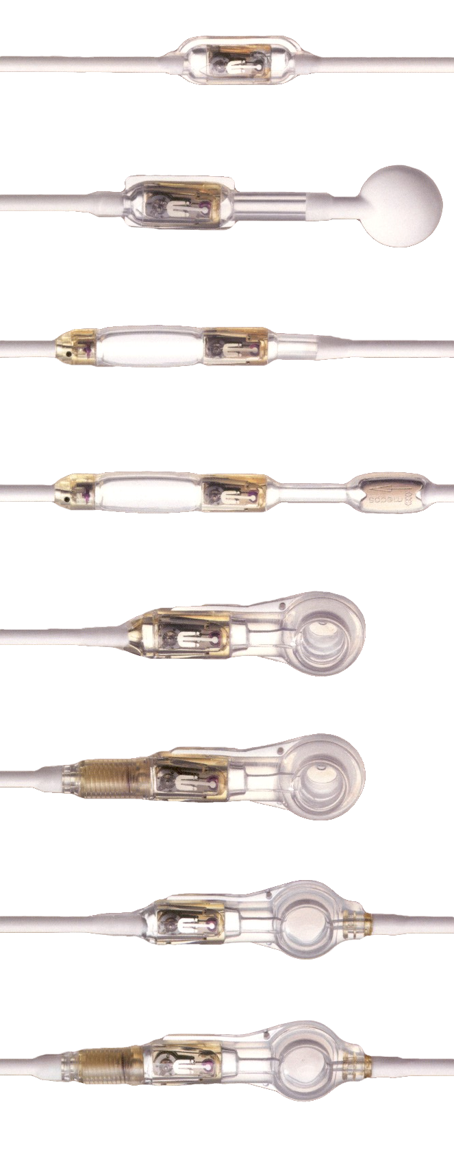
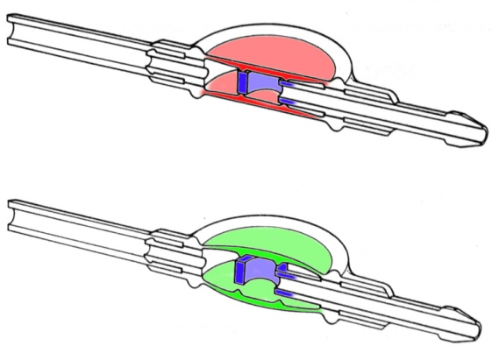
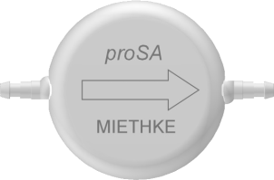
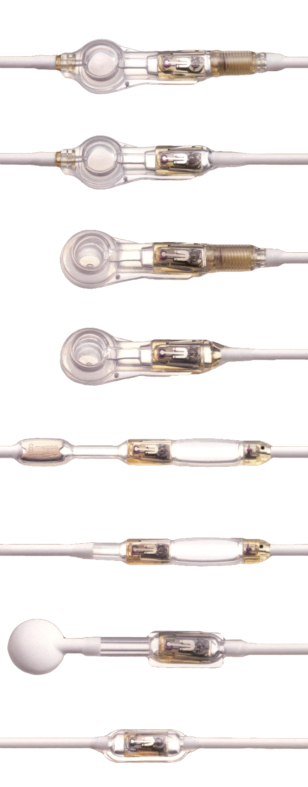
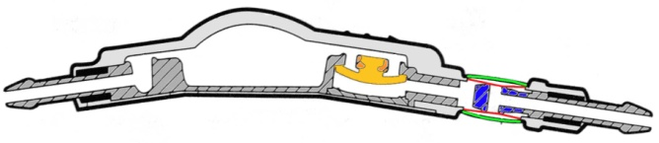
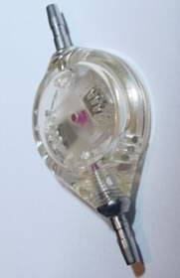
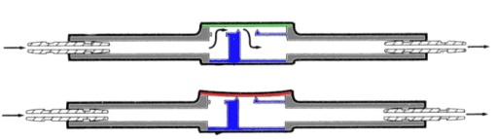
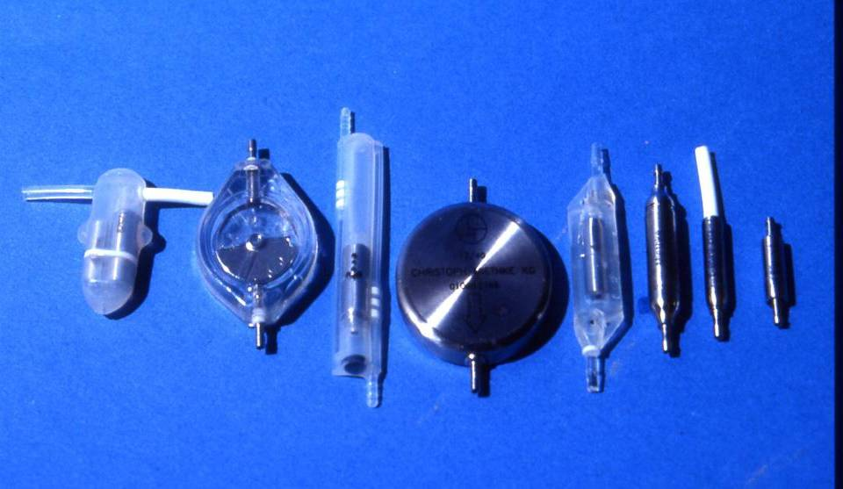
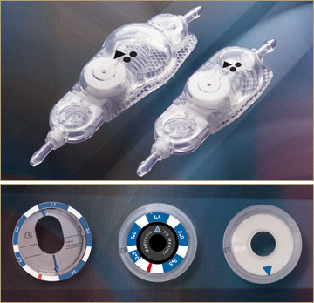
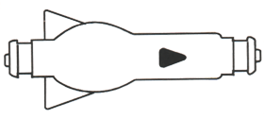
The Jungle of Shunt Systems

Slide 13
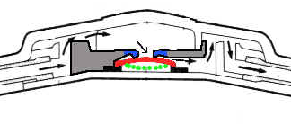
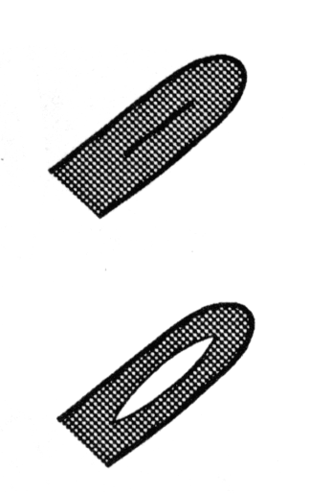

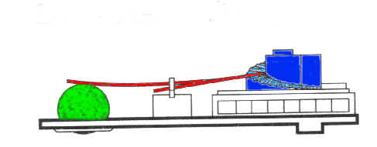
Valve technology - Systematics
Valve mechanisms:
  differential pressure valve (slit, membrane, ball)
    adjustable valves (ball-valves)
Membrane valve
Slit-valve
Ball cone-valve
Adjustable valves
Notes:
13

Slide 14
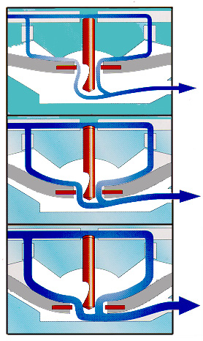
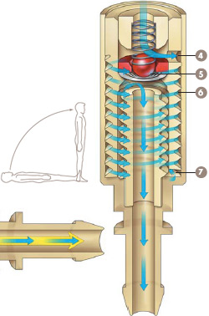
Valve technology - Systematics
Valve mechanisms:
  flow control valve
Notes:
14

Slide 15
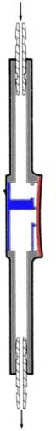
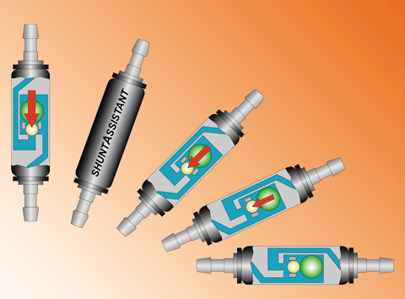
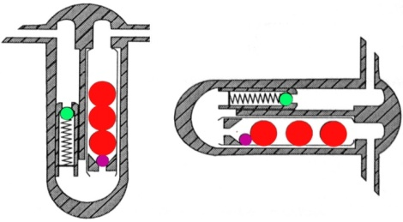
Valve technology - Systematics
Valve mechanisms:
  hydroststatic devices
    anti-siphon-device
    gravitational device
    (flow control)
Notes:
15

Slide 16

The Jungle of Shunt Systems
about 130 different valves
about 450 different pressure settings
Which valve should I use?

Slide 17
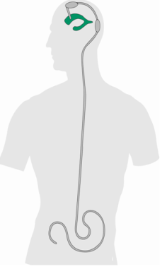
ICP in vertical and horizontal position with DP-valve
ICPvp = VOP - HPD + IAP

Slide 18
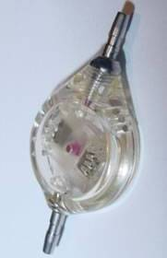
resulting ICP with different valves

Slide 19
ICP with Shuntassistant
ICPvp = VOP - HPD + IAP + SA
19
Notes:
19

Slide 20
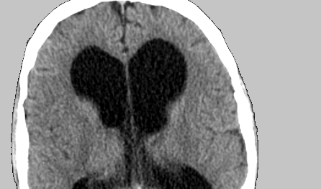
SVASONA interim analysis
Shunt valves plus shunt assistant versus shunt valves alone for controlling overdrainage in idiopathic normal-pressure hydrocephalus in adults
U. Meier and J. Lemcke (Dept. of Neurosurgery, Unfallkrankenhaus Berlin, Germany)
C. Müller, M. Fritsch, M. Kiefer, R. Eymann, U. Kehler, N. Langer,
M. U. Schuhmann, A. Speil, F. Weber, V. Remenez, V. Rohde, C. Ludwig,
D. Stengel
Courtesy by Prof Meier, Berlin

Slide 21
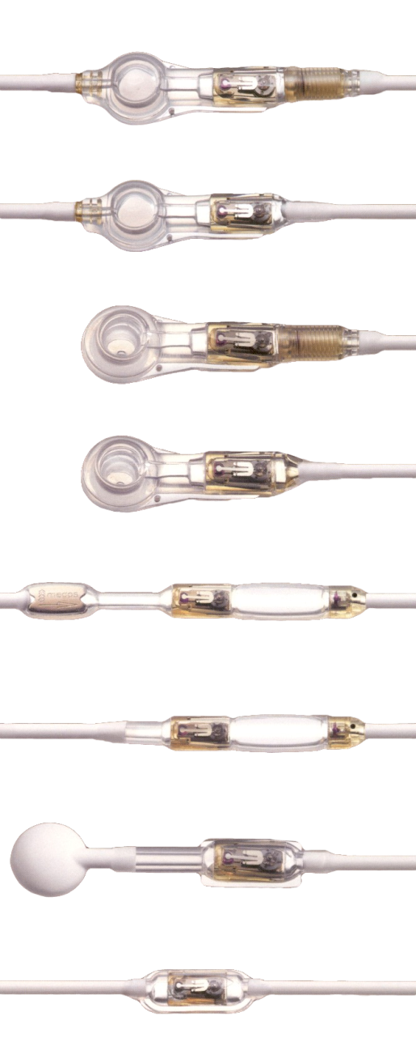
SVASONA-Study
Meier,U et al
comparing
progr. DP valve without gravitationan device (Medos Codman)
with
progr. DP valve with gravitational device (proGAV)

Slide 22
Svasona Outcome
Codman Medos
ProGAV
20
15
Kiefer Scale
10
5
0
Baseline
6 months
Courtesy by Prof Meier, Berlin

Slide 23
Interim Analysis
completed 6 m follow up | CMPV without gravity unit 53 patients (80%) | proGAV with gravity unit 59 patients (88%)
6 m symptoms [Kiefer score] | 4.96 ± 4.34 | 3.97 ± 3.59
Evan’s index | 0.34 ± 0.06 | 0.35 ± 0.04
overdrainage (Fischer’s exact test p<0.001) | 20 (38%) | 2 (3%)
underdrainage | 0 (0%) | 0 (0%)
Courtesy by Prof Meier, Berlin

Slide 24
SVASONA-Study
Meier,U et al
comparing
progr. DP valve without gravitational device (Medos Codman)
against
progr. DP valve with gravitational device (proGAV)
Same results but more overdrainages in valves
without gravitational devices (highly significant)
Class 1 evidence!

Slide 25
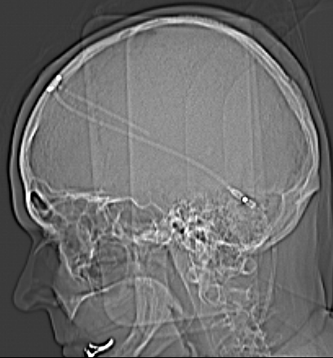
Devices against overdrainage
Shunt-Assistant:
Problems:
vertical implantation
implantation site
choice of ball weight

Slide 26
VP– Shunt: How I do it
first surgery of the day
CRP < 5mg/l
pre-op: antibiotics (cephalosporin) – single shot
no traffic in the OR
quick surgery (simultaneous head and abdomen)
no touch technique
valve/shunt test before skin suture

Slide 27
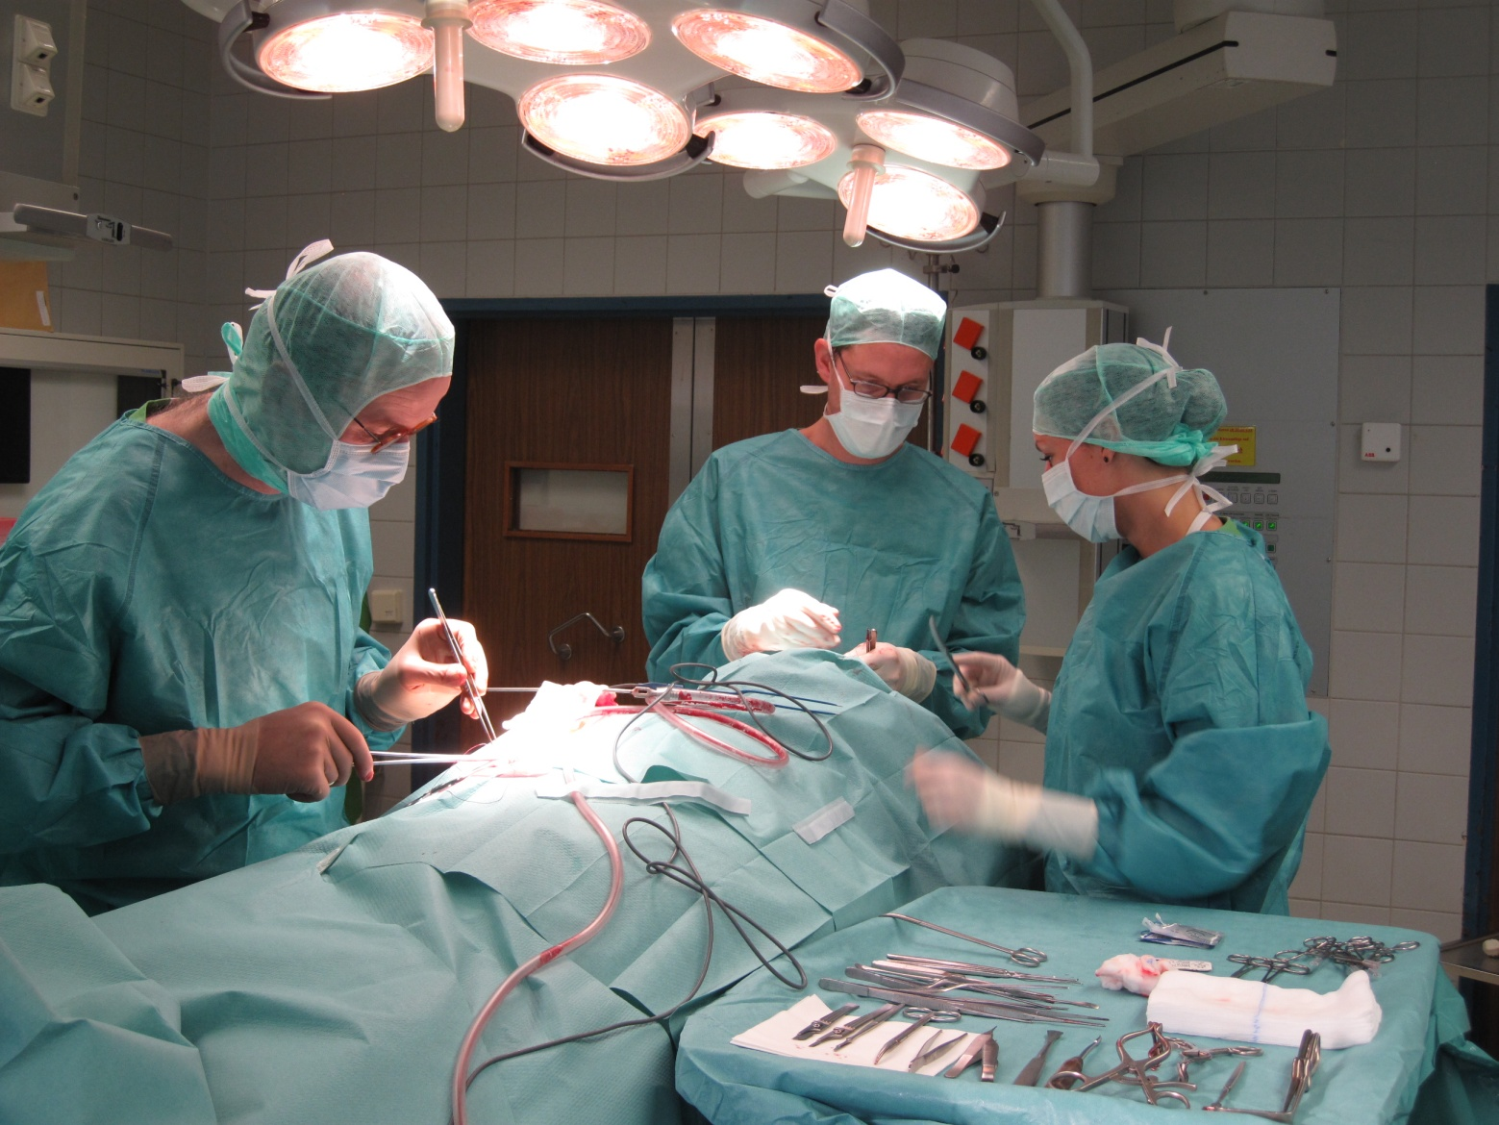
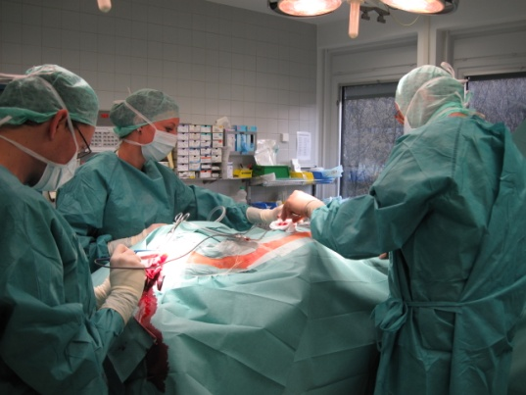
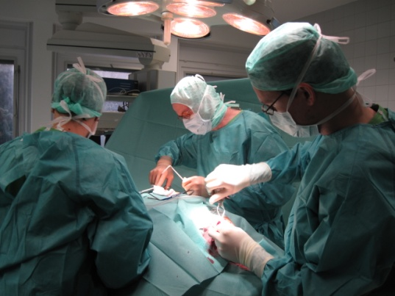
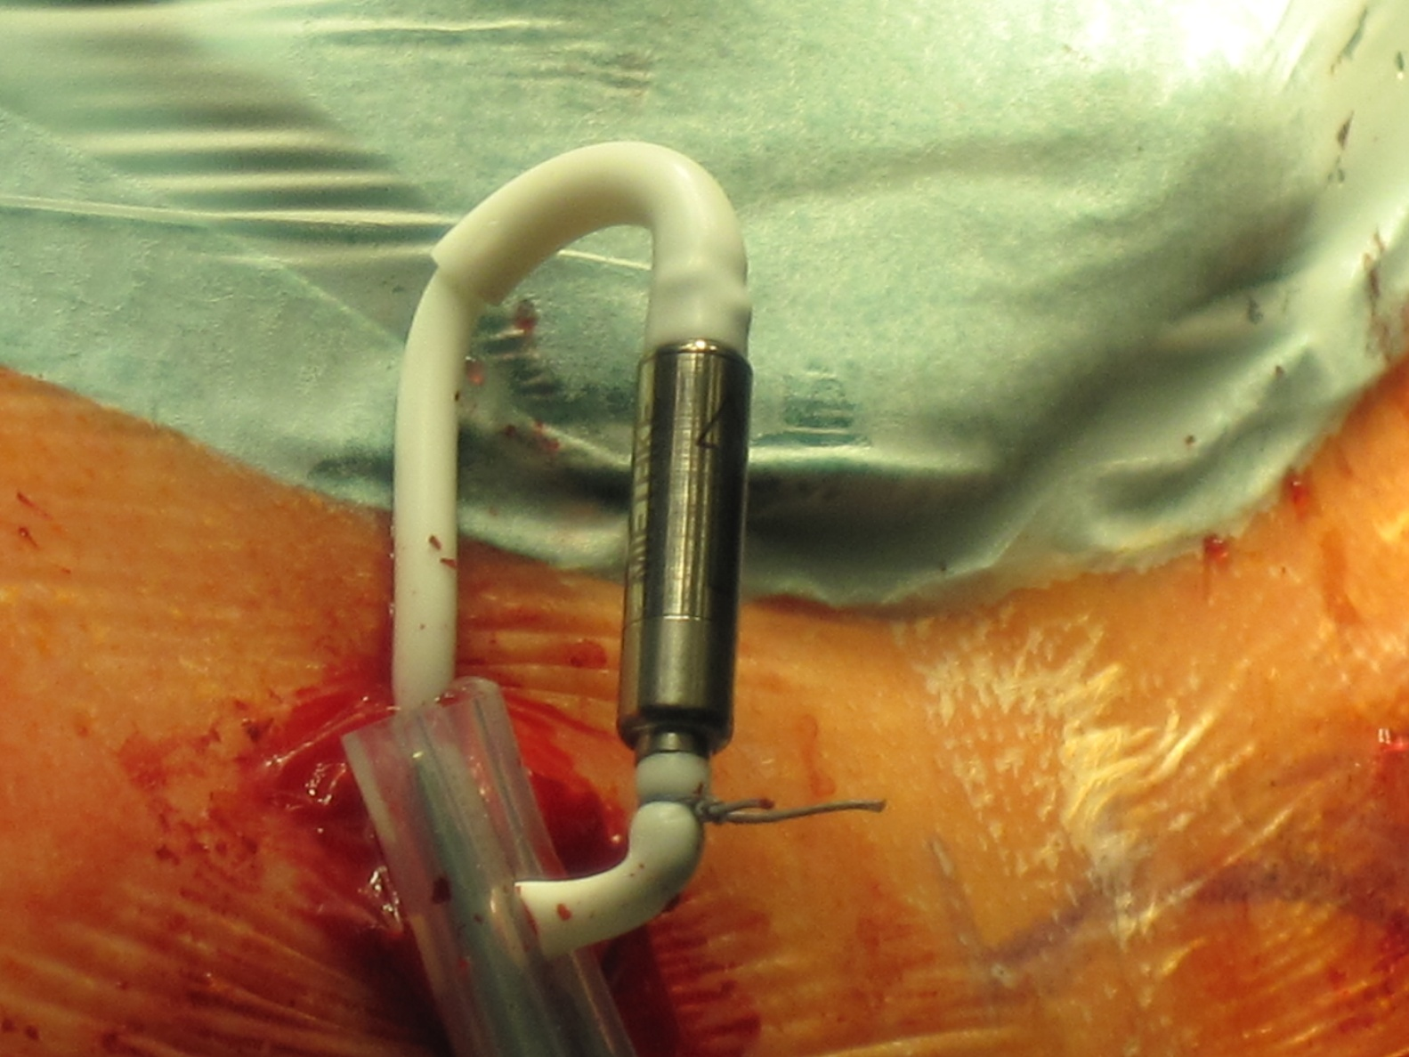
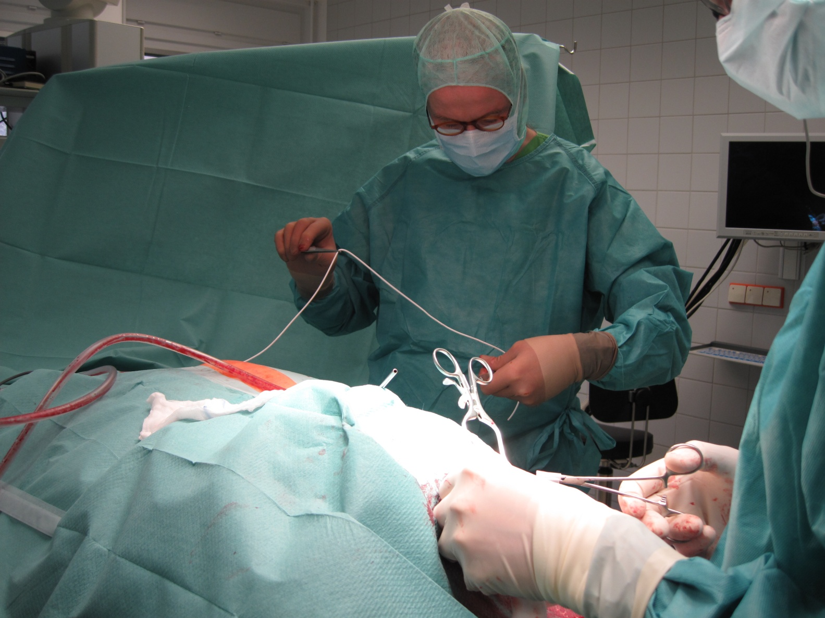
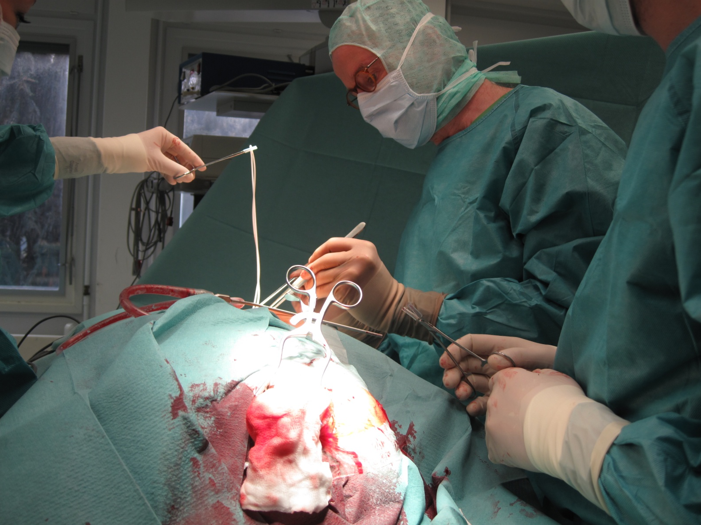
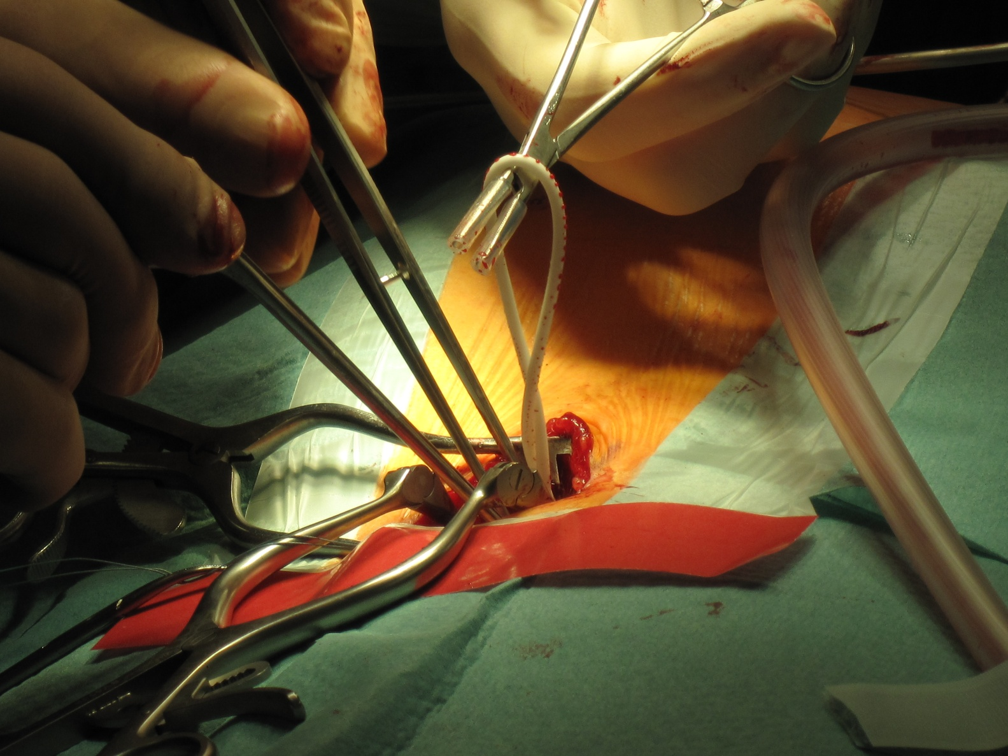
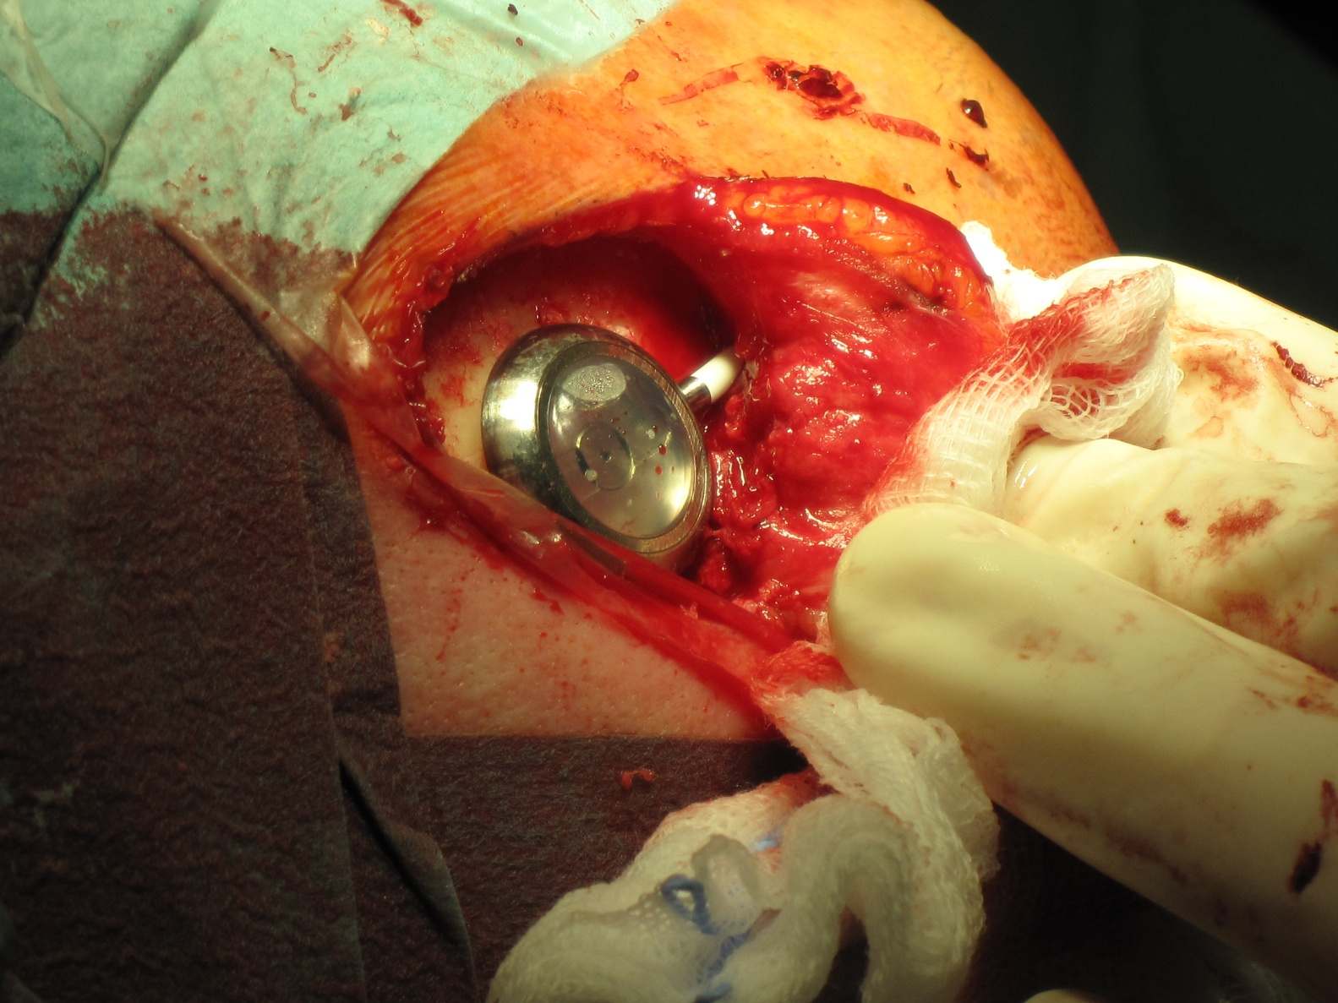

VP_Shunt: How I do it

Slide 28


VP_Shunt: How I do it
Notes:
28

Slide 29

VP_Shunt: How I do it
Ventricle puncture first with a Cushing canula
introducing prepared (6cm long) ventricular catheter - connected to a flushing reservoir
Notes:
29

Slide 30



VP_Shunt: How I do it
Notes:
30

Slide 31


VP_Shunt: How I do it
Notes:
31

Slide 32


VP_Shunt: How I do it
Notes:
32

Slide 33


VP_Shunt: How I do it
Notes:
33

Slide 34


VP_Shunt: How I do it
Notes:
34

Slide 35

VP_Shunt: How I do it
Notes:
35

Slide 36




VP_Shunt: How I do it
purse-string stitch at the peritoneum:
Notes:
36

Slide 37
VP– Shunt: How I do it
Pre-op antibiotics
length of ventricular catheter: 6 cm (frontal burrhole)
length of peritoneal catheter: ca. 40 cm
most frequently used valve setting:
GAV 5/30
our results:
Infections 2,8%, Obstructions 9,7%, Overdrainage 4,0 %
Notes:
37

Slide 38
VP– Shunt: Contraindications
meningitis => EVD, rep. LP or lumbar drainage
slit ventricles => lumboperit. Shunt
abdominal pathology (no resorptive capacity) => VA- Shunt
Notes:
38

Slide 39




Shunt and MRI
a shunt is no contraindication for MRI
but artefacts in MRI (ferromagnetic metals)
some adjustable valves may be altered in the magnetic field (Sophy, Medos Codman, Strata) and must be readjusted after MRI examination
Polaris, proGAV und proSA have „brakes“ and do not shift in MRI (up to 3 Tesla)
Dept. of Neurosurgery, Asklepios Klinik Hamburg Altona
39
Notes:
39

Slide 40



developments of catheters
bioglide catheter
silberimprägnierte Katheter
Antibiotika-imprägnierte Katheter
Dept. of Neurosurgery, Asklepios Klinik Hamburg Altona
40
Notes:
40

Slide 41


Hydrocephalustherapie heute
DD: Alzheimer oder
Normaldruckhydrocephalus
Thank you
very much
Assesment of low-flow CSF drainage as a treatment for AD
G.D. Silverberg et. al
Neurology 2002; 59: 1139-1145
u.kehler@asklepios.com
Notes:
41

Slide 42




adjusting a valve
proGAV

Slide 43
Calculation of ICP in vp-shunted patients
    ICPvp = VOP - HPD + SA + IAP
    HPD VOP IAP SA
    HPD = hydrostatic pressure difference
    VOP = valve opening pressure
    IAP = intra-abdominal pressure
    SA = gravitational shunt assistant
HPD

Slide 44
Calculation of ICP in vp-shunted patients
    ICPvp = VOP - HPD + SA + IAP
    + + + = -5 to + 10cm H₂0
    HPD VOP IAP SA
    HPD = hydrostatic pressure difference
    VOP = valve opening pressure
    IAP = intra-abdominal pressure
    SA = gravitational shunt assistant
HPD

